Slide 1
Structured Query Language

Slide 2
The Structured Query Language
SQL-86 is the first standard
SQL-92
(SQL2)
SQL:2003
IBM Develops the first SQL in the late seventies
SQL-89
SQL-89
(SQL3)
1977
1986
1989
1992
1999
2003

Slide 3
Queries
SELECT
Used to retrieve information from a database
Syntax:
select colum_name_a, column_name_b from table_name

Slide 4
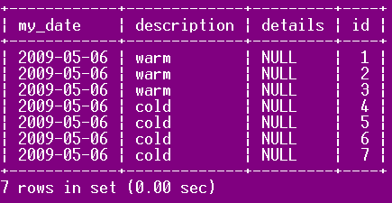
Queries
select * from forecast_data

Slide 5
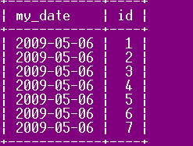
Queries
select my_date, id from forecast_data

Slide 6
DISTINCT
The distinct keyword returns only unique occurrences of a particular field
Syntax:
select distinct column_a, column_b from table_name

Slide 7
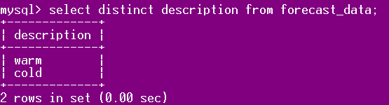
DISTINCT

Slide 8
WHERE
Used to retrieve records that fit a criteria defined in the where clause
select column_a, column_b from table_name where column_name operator value

Slide 9
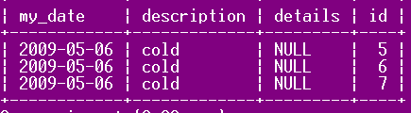
WHERE
select * from forecast_data where id > 4;

Slide 10
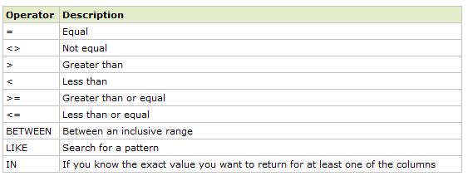
Operators in the WHERE Clause

Slide 11
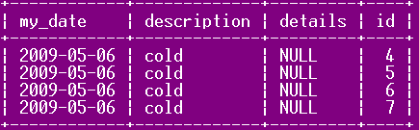
AND …OR
select * from forecast_data where id > 6 OR description='cold';

Slide 12

AND..OR
select * from forecast_data where id > 6 AND description='cold'or details is not null;

Slide 13
ORDER BY
order by is used to order a list of records retreived
select column_a, column_b order by column_a,column_b asc|desc

Slide 14
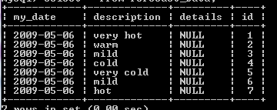
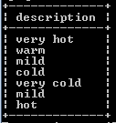
ORDER BY
select description from forecast_data asc

Slide 15
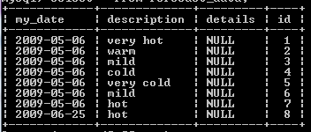
INSERT
insert into forecast_data values (curdate(), 'hot', NULL,8);

Slide 16
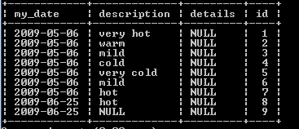
INSERT Into Specified Columns
insert into forecast_data (my_date,id) values (curdate(),9);

Slide 17
UPDATE
Modify existing records within a table.
update table_name set column_1 = value, column_2=value where column_3 = x

Slide 18
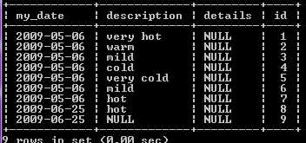
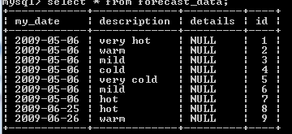
UPDATE
update forecast_data set description='warm', my_date=curdate() where id = 9

Slide 19
DELETE
delete from tablename where column_a = value

Slide 20
DELETE
Delete records from a table. May be used with a where clause.
delete from tablename where column_a = value

Slide 21
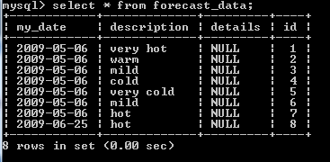
DELETE
delete from forecast_data where id = 9

Slide 22
A nice page to try a few queries
http://www.w3schools.com/SQl/sql_tryit.asp

Slide 23
More SQL

Slide 24
LIMIT
Limit the number of records returned in a query
LIMIT {[offset,] row_count | row_count OFFSET offset}

Slide 25
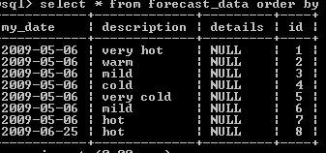

LIMIT
rowcount
select id from forecast_data order by id limit 5,1
offset
Limit the number of records returned in a query

Slide 26

LIKE and NOT LIKE
Select records having a description field with anything after the word "very"
select * from forecast_data where description like 'very%'

Slide 27

LIKE and NOT LIKE
select * from forecast_data where description like '%cold'

Slide 28
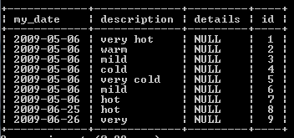
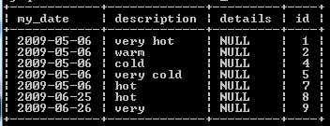
LIKE and NOT LIKE
select * from forecast_data where description NOT LIKE '%il%'

Slide 29

Single Character Wildcard '_'
select * from forecast_data where description LIKE 'v_ry c_ld'

Slide 30
REGEXP
A very cool and powerful capability in MySQL and other databases is the ability to incorporate regular expression syntax when selecting data.

Slide 31
REGEXP
. match any character ? match zero or one * match zero or more + match one or more {n} match n times {m,n} match m through n times {n,} match n or more times ^ beginning of line $ end of line

Slide 32
REGEXP
[[:<:]] match beginning of words [[:>:]] match ending of words [:class:] match a character class i.e., [:alpha:] for letters [:space:] for whitespace [:punct:] for punctuation [:upper:] for upper case letters [abc] match one of enclosed chars [^xyz] match any char not enclosed | separates alternatives

Slide 33
REGEXP
MySQL interprets a backslash (\) character as an escape character. To use a backslash in a regular expression, you must escape it with another backslash (\\).

Slide 34

REGEXP
select * from forecast_data where description regexp '^[mh].*'

Slide 35

COUNT(*)
select count(*) from forecast_data where description regexp '^[mh].*'

Slide 36
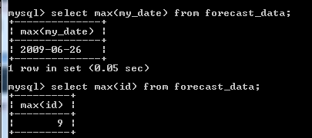
MAX and MIN
Retrieves the maximum or minimum from a specific table or set of records (numbers, string(varchar), and dates)

Slide 37
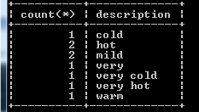
COUNT(*) and GROUP BY
Collect records into groups
select count(*) from forecast_data group by description

Slide 38
IN
Specify multiple values in a where clause. Equivalent to using multiple OR
Select column_a from table_name where column_a in (value_a, value_b)

Slide 39

IN
select * from forecast_data where id in (1,4,6)

Slide 40
BETWEEN
Select records within a range of two values (dates, strings (varchar), numbers)
select column_a from table_name where column_a between value1 and value2;

Slide 41
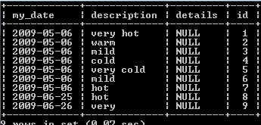

BETWEEN
select * from forecast_data where my_date between '2009-05-07' and curdate();

Slide 42
Alias
An alias can be used for columns or tables
This makes queries easier to read, shorter
An alias for a table
select column_name from table_name as alias_name
An alias for a column
select column_name as alias_name from table_name

Slide 43
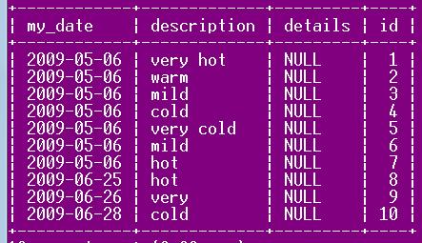
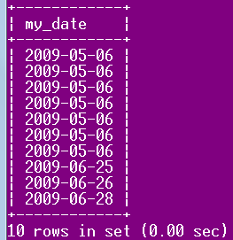
Table Alias
select f.my_date from forecast_data as f

Slide 44
Join
Used to query data from multiple tables using relationships between fields in each table
Inner Join
Left Join
Right Join
Full Join

Slide 45
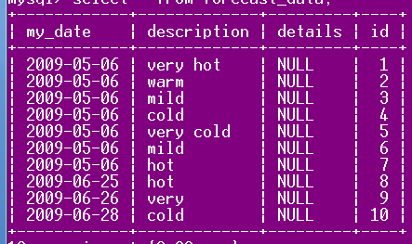
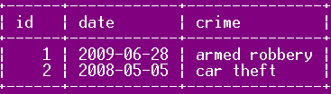
Two Tables
forecast_data table
crime table

Slide 46

Inner Join
Select records which have a match in both tables. Records without a match in the corresponding table will not be shown
select column_name from table_a inner join table_b on table_a.id = table_b.id_val

Slide 47

Inner Join
select forecast_data.description,crime.crime from
forecast_data inner join crime
on forecast_data.my_date = crime.date;

Slide 48
Inner Join Alternate Syntax (same effect)
select forecast_data.description,crime.crime
from
forecast_data , crime
where
forecast_data.my_date = crime.date;

Slide 49
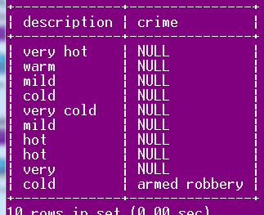
Left Join
Return all records from the left table, even if there are no matches.
select forecast_data.description,crime.crime from
forecast_data left join crime
on forecast_data.my_date = crime.date;

Slide 50
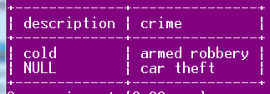
Right Join
Return all the records from the right table even if there are no matching records
select forecast_data.description,crime.crime
from forecast_data right join crime
on forecast_data.my_date = crime.date;

Slide 51
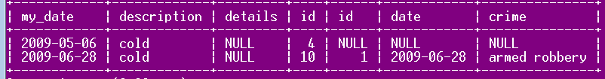
Adding Where Clause to Joins
select * from forecast_data left join crime
on forecast_data.my_date = crime.date
where forecast_data.description = 'cold'

Slide 52
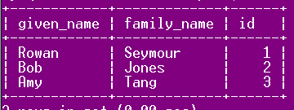
Adding a Third Table
The Suspect table

Slide 53
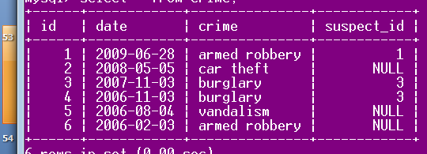
Updated Crime Table
Now there is a suspect id column

Slide 54
Joining Multiple Tables
Show a crime with the weather for that day and the suspect in the crime
select * from
(crime inner join forecast_data
on my_date = date)
inner join suspect
on suspect.id = crime.suspect_id;

Slide 55
Full Outer Join
Return all rows from each table, even if there is no match in the corresponding table

